Slide 1
3370- Software Engineering
Table Plus Plus
04/28/2023
Too Inspired To Be Tired
Requirements Engineer/Domain Analyst – Kevin White
Software Developer- Janavi Bhalala
Software Tester – Lauran Lutz
Quality Assurance Manager – Will Jamison
Project Manager- Christine Burinda

Slide 2
Presentation Outline
Project Vision
Project Planning
Project Requirements
Product Design
Project Implementation
Product Testing
Lessons Learned
Product Launch / Demonstration
Questions

Slide 3
Project Vision
We created TablePlusPlus to ease the users experience when keeping track of multiple items. Simplifying the mundane of inventory management.
The main stakeholder for this project is the IT Department in the Bell Library.

Slide 4
Project Vision
We are unlike excel and google sheets which are user friendly applications and more accessible.
Our product was built to easily modified and changed while coming with an easy-to-use user interface to provide streamline access to non-tech savvy individuals.

Slide 5
Project Planning
We used Discord as a means of communication and agreed to a weekly in-person meeting at the library every Friday at 5:00 PM. Additionally, we decided to convene as needed throughout the week.
We utilized the iterative process as it involved repeated iterations of refining and improving our work through multiple feedback cycles until we achieved the desired final outcome.

Slide 6
Project Planning
The risk of accidental data loss during new data upload is the most critical risk in this project. To address this issue, we implemented a "Restore Data" button on our website, which enables the retrieval of any unintentionally deleted data.
The iteration process turned out to be a great process because we would get feedback which helped us improve and get better

Slide 7
Project Requirements
Table Plus Plus will be used by two types of users - a regular user and a code editor. The regular user will be able to add, remove, and search for data within the database, while the code editor will have access to the program's code to make any required updates and modifications.
The main use cases for this project are as follows uploading and downloading data, adding, editing, and deleting information, searching, sorting, and pagination of information.

Slide 8
Project Requirements
Some of our major requirements include uploading data, downloading data to a file, editing information, searching information, deleting information and sorting information

Slide 9
Product Design
Some main design decisions include using JavaScript for working with the data received from costumers, using HTML & CSS for making the website look prettier and accessible. Some of the classes that we have added into our codes are add, search, edit and remove. We also have the sorting class that helps sort data per user’s selected column. The pagination feature organizes the display to be in pages compared to scrolling

Slide 10
Product Design
Some constraints include importing CSV file , input from scanner and being connected to library employee network to access the database.
Our software design includes adding data, deleting data, editing data, searching for data, uploading & downloading data, time stamp to keep a track of when the data was last edited, sorting the data in ascending or descending order and lastly pagination.

Slide 11
Product Design
The user interface design for our product is as follows:
Choose the file button: This button allows the user to select the csv file
Upload CSV: This button uploads the chose file
Download CSV: This button downloads the table to a new CSV file
Add Item button: The add item button allows user to add new items in the table

Slide 12
Product Design
User interface continued:
5) Delete check box: This box allows the user to delete an entire row
6) Edit: This box allows the user to edit the data in the cell
7) Sorting Column Arrows: This is a button located at the top of each column displayed and sorts the list by column

Slide 13
Project Implementation
We used Visual Studio & GitHub as the approach for product implementation
We were able to achieve teamwork during product implementation is by having weekly meetings and communicating through Discord.

Slide 14
Product Testing
The most important test case is the activity test. This test verifies that all user interface elements work as intended and this test takes up to 0.5 hours.
Another important test case is barcode search test. This test verifies that Mary and Jeff Bell IT Department’s existing hardware and software compatible with the system and this test takes about 5 minutes
Both of these tests were successful

Slide 15
Lessons Learned
The most challenging aspect of this project is writing the requirements document and constructing domain models
Motivation: teamwork and demotivation: pivoting the structure of the program and having real client who doesn't want what they had
Something we would have done differently is distributed the work more evenly
Success that we considered in this project is that the program is running and the customer is happy
Thing we should have improved: uploading any data files and downloading any data files, not just CSV

Slide 16
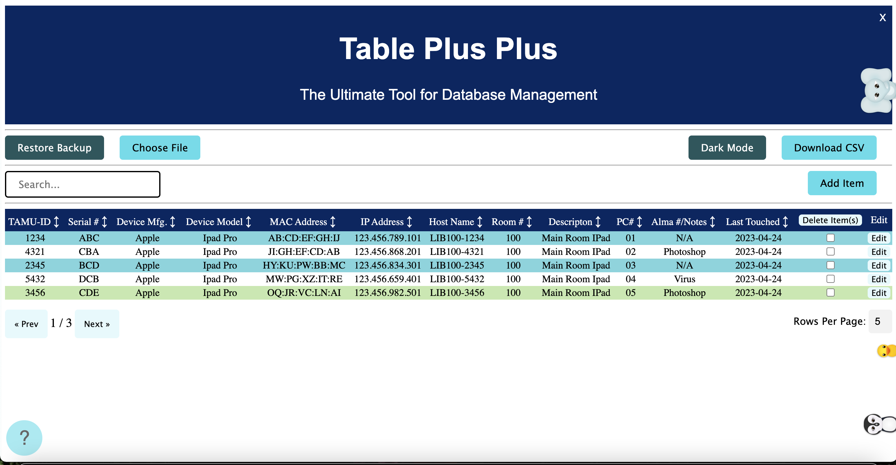
Product Features

Slide 17
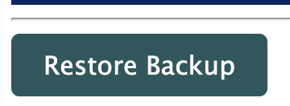
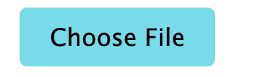
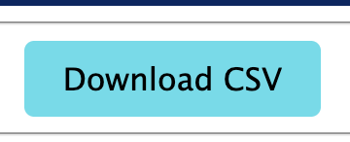
Product Features
Restore Backup :
Choose File:
Download CSV:

Slide 18
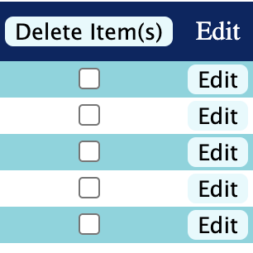
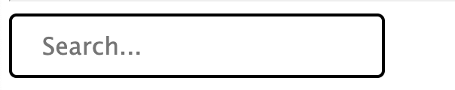
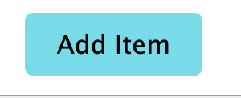
Product Features
Delete and Edit Items:
Search Item
Add Item

Slide 19


Product Features
Pagination
Sorting Arrows:

Slide 20
Project Demonstration

Slide 21
Q&A

